Slide 1




Emerging Skills
Report
Rizki Darmawan November 23, 2022

Slide 2

OUTLINE
Executive Summary
Introduction
Methodology
Results
Visualization – Charts
Dashboard
Discussion
Findings & Implications
Conclusion
Appendix

Slide 3

EXECUTIVE SUMMARY
Obtain data from surveys, web scraping to find jobs by location, and an API to determine the average annual income of each programming language. The data obtained provides insights into the top programming languages, databases, and web frames trends for this year and next year. The gathered information was visualized in a dashboard for ease of understanding.

Slide 4

INTRODUCTION
This report provides an overview of the current and future trends in the programming industry, specifically focusing on programming languages, databases, operating systems, and job demand. The report aims to give insights into the most popular programming languages, databases, and operating systems, as well as the demand for jobs in the field. By analyzing data gathered from surveys, web scraping, and APIs, the report aims to provide a comprehensive understanding of the current state of the programming industry and its future prospects. The findings of this report will be valuable for individuals interested in pursuing a career in the programming industry or for organizations looking to stay current with the latest industry trends.

Slide 5

METHODOLOGY
Obtained Job APIs in the form of JSON files
Converted JSON files into a data frame using python's pandas
library
Used seaborn library to create a bar chart
Used BeautifulSoup to extract a table from an HTML
Pandas library to convert HTML to a data frame
Used IBM's Watson Studio to create a Dashboard of Top Programming Languages

Slide 6
RESULTS
JavaScript is the most common Language
Python is on the rise next year​
Python goes from 9th most popular this year to 2nd next year
JavaScript, HTML, SQL will still be top Languages next year
MySQL is the leading Database this year​
Linux, Windows and AWS are the leading Platforms
React.js will be the top Web Frames learned next year​

Slide 7
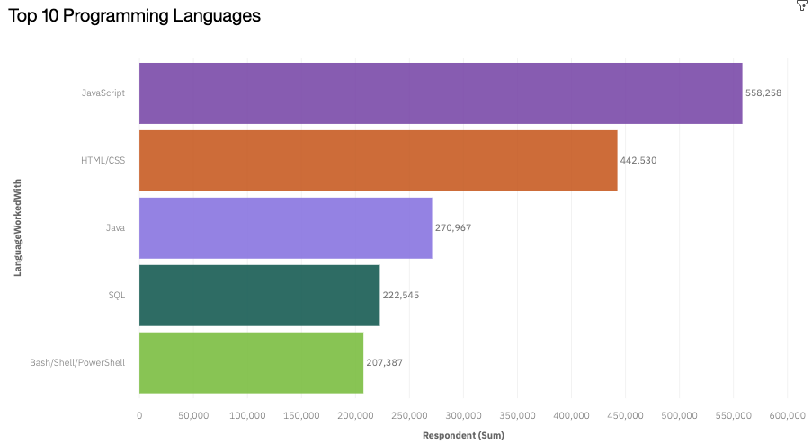
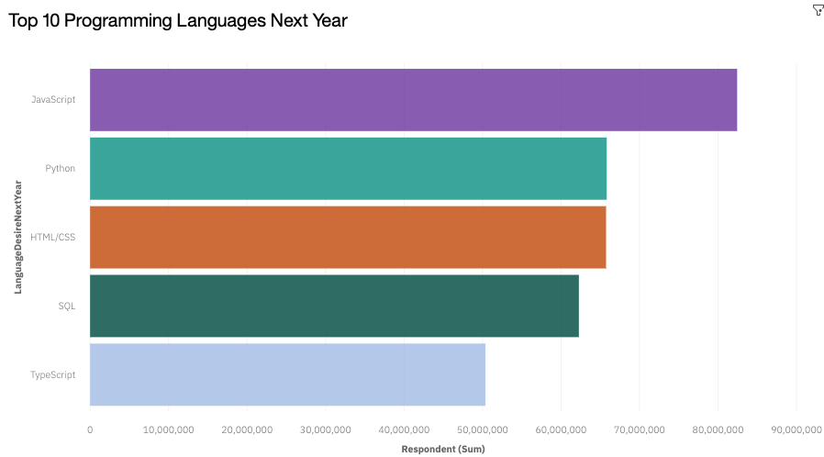
PROGRAMMING LANGUAGE TRENDS
Current Year
Next Year
< Bar chart of top 5 programming languages for the next year goes here.>

Slide 8
PROGRAMMING LANGUAGE TRENDS - FINDINGS & IMPLICATIONS
Findings Implications
JavaScript is #1 this year and next year
Python jumped to #2 from not being in the top 5 this year
SQL is #4 this year and next year
There is a high demand for JavaScript Programmers
The Python Language is gaining popularity
There isn't a strong increase in demand for SQL

Slide 9
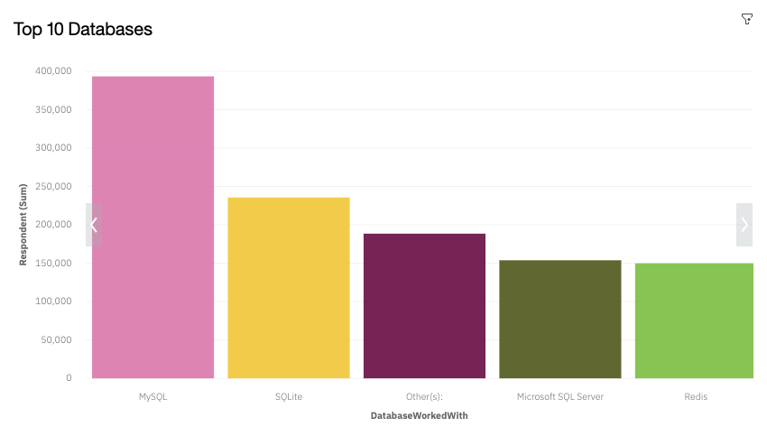
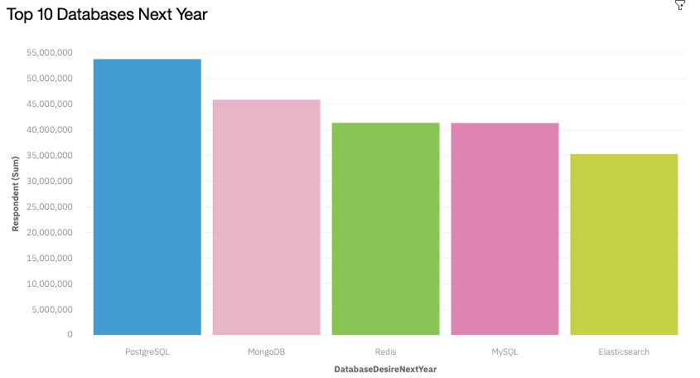
DATABASE TRENDS
Current Year
Next Year

Slide 10
IMPLICATIONS
DATABASE TRENDS |  | - FINDINGS | &
Findings |  | Implications
MySQL is the overwhelming majority this year, but ranked only 4th most popular next year
PostgreSQL is the top Database to learn next year
SQLite was #2 this year, but is not a top 5 Database next year
Other Databases are emerging as competitors to MySQL
PostgreSQL is vastly popular next year and we should monitor it closely
SQLite is not as popular anymore

Slide 11

DASHBOARD
https://dataplatform.cloud.ibm.com/dashboards/7e3eaf81- 9959-4e91-89ac-
b06a57263937/view/0617e3776ebd75c154f7c8e407ca7d02
7d317158b6bb820180877b4906682597f06841c4c8281a5b8
e18056af7ea120b9d

Slide 12
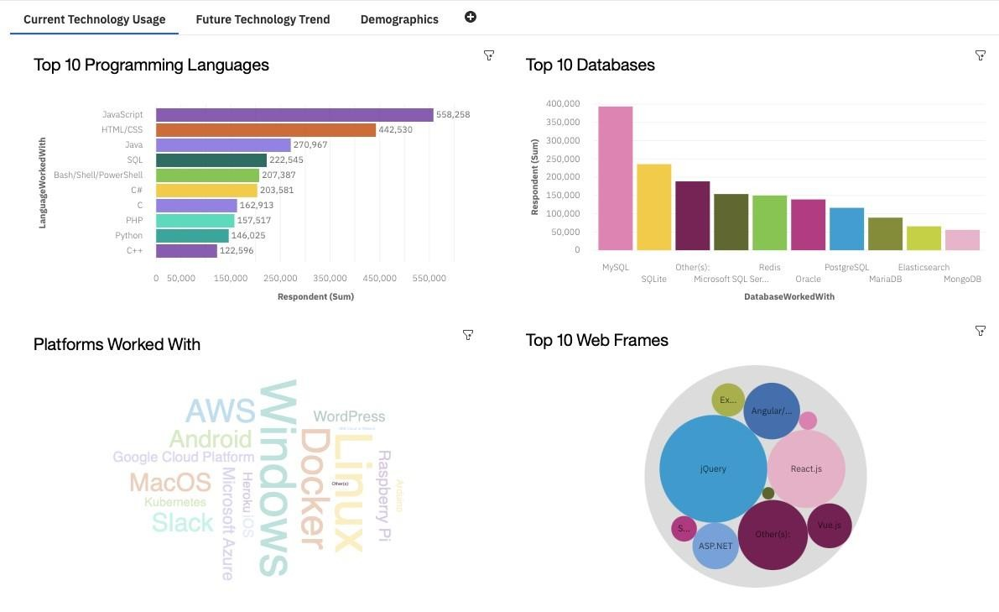
DASHBOARD TAB 1

Slide 13
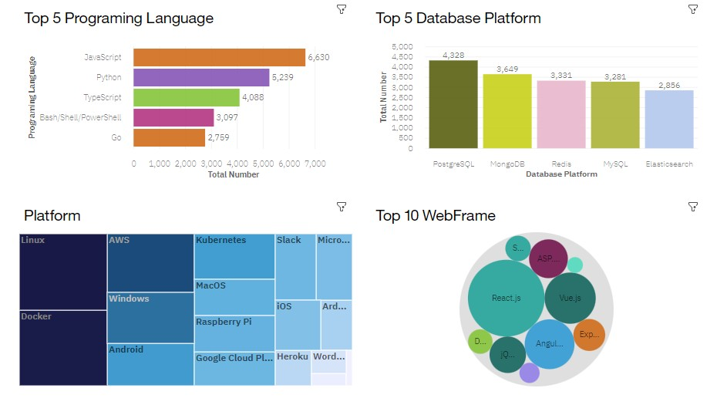
DASHBOARD TAB 2

Slide 14
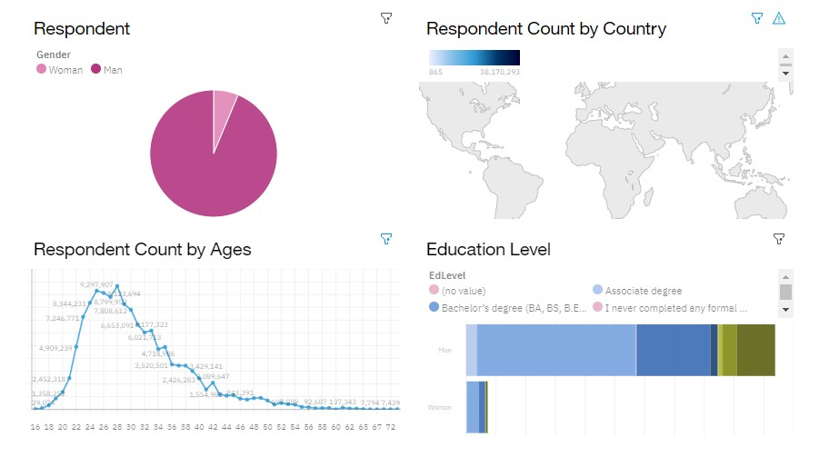
DASHBOARD TAB 3

Slide 15
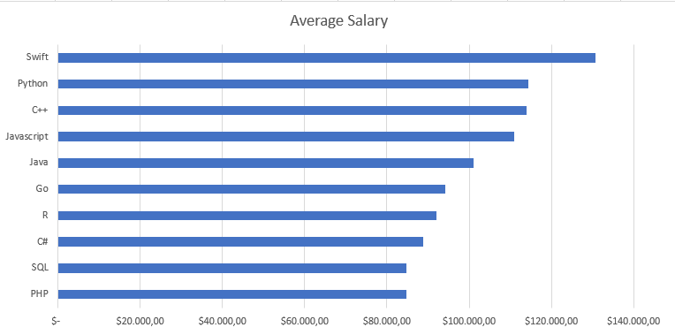
POPULAR LANGUAGES

Slide 16
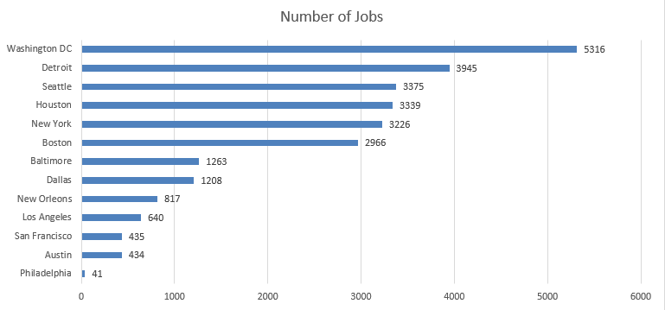
JOB POSTINGS

Slide 17
DISCUSSION
Just because a Language or Database isn't as popular to learn next year doesn't necessarily mean it is less popular. It might mean that it is already widely known

Slide 18
OVERALL FINDINGS & IMPLICATIONS
Implications
Findings
Most respondents have a Bachelor's degree
Linux is the top Platform to learn next year
Swift Programmers are the highest paid on average
Most companies prefer applicants with at least a Bachelor's degree
Linux' support for high-volume makes it an emerging Platform

Slide 19

CONCLUSION
Swift, Python, and C++ Programmers are the highest paid on average
Python is growing in popularity due to ease of use
MySQL and PostgreSQL are the leading Database of the present and future

Slide 20
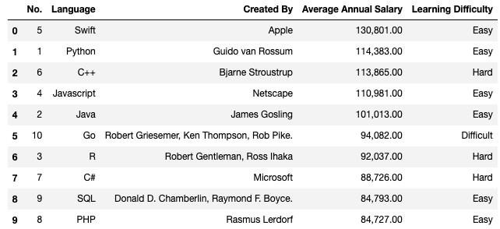

APPENDIX

